Slide 1



CASE STUDY
DEFI LIQUIDITY CRISES: WHEN MARKETS FREEZE
Course: Decentralized Finance (HBCC801)
(Continous Assesment 1)
Academic Year: 2025-26
Name: Sanika Jadhav (D16AD-B/20)

Slide 2

INTRODUCTION
What Is Liquidity in DeFi?
Liquidity refers to how easily assets can be traded or withdrawn without major price changes.
In DeFi, liquidity is provided by users, not institutions
Key Indicators of Liquidity in DeFi:
Pool Depth : Amount of capital available in liquidity pools for trades and swaps
Trading Volume : Frequency and size of transactions occurring on the platform
Slippage: Price impact of executing trades—lower slippage means better liquidity

Slide 3
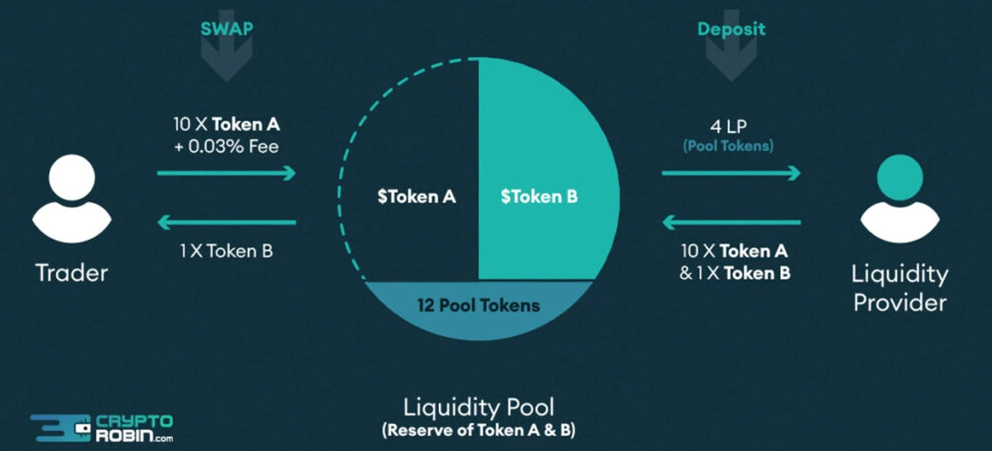
LIQUIDITY P00LS
Liquidity Pools (AMMs): Users deposit token pairs into smart contracts, enabling continuous token swaps without intermediaries.

Slide 4
WHAT IS A DEFI LIQUIDITY CRISIS?
A DeFi liquidity crisis occurs when liquidity vanishes suddenly, often due to panic, extreme volatility, or design flaws. Unlike traditional finance, DeFi crises unfold rapidly and automatically, driven by smart contracts.
What Happens During a Liquidity Crisis?
Liquidity providers rush to withdraw funds
Lending pools dry up
Stablecoins or collateral assets lose value
Users are unable to trade, withdraw, or borrow assets efficiently
Results in high slippage, frozen withdrawals, and forced liquidations

Slide 5
MASS WITHDRAWALS (BANK-RUN EFFECT)
A mass withdrawal event in DeFi closely resembles a traditional bank run, but it occurs much faster because there are no human decision-makers—only smart contracts.
Market crashes, rumors, or loss of trust trigger panic withdrawals
Liquidity providers rush to remove funds from pools
Liquidity pools shrink rapidly, reducing pool depth
Trades fail or suffer extreme slippage due to thin liquidity

Slide 6
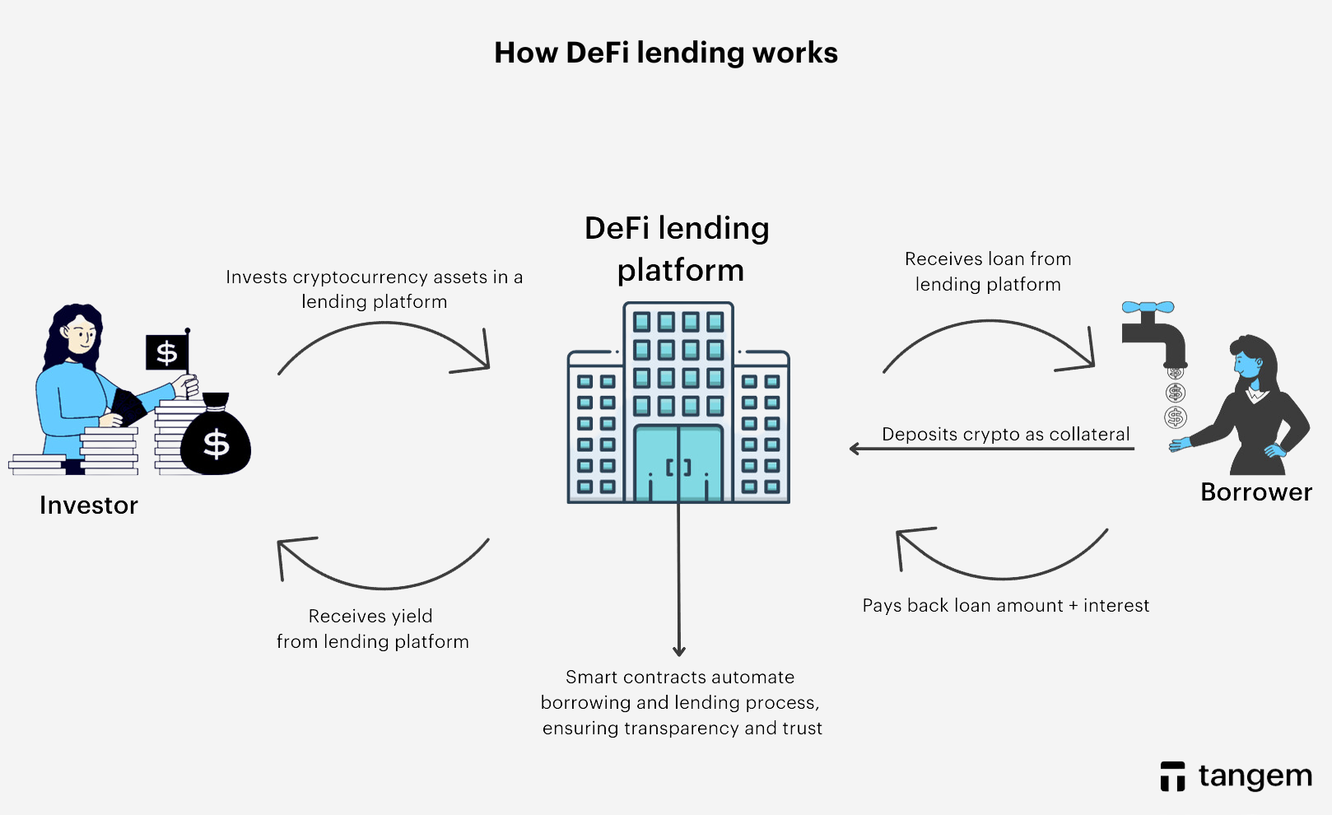
COLLATERAL LIQUIDATION CASCADE
In DeFi, users take loans by keeping crypto as collateral
When the price of that crypto falls, the collateral value becomes too low
The system automatically sells (liquidates) the collateral to recover the loan
These forced sales push prices down even more, causing more liquidations

Slide 7
STABLECOIN DEPEGGING
Stablecoin depegging occurs when a stablecoin fails to maintain its fixed value (usually 1 coin = $1), leading to loss of trust and liquidity in DeFi markets.
DeFi loans and pools using the stablecoin as collateral or trading pair become unstable
Users lose trust and exit positions to avoid losses
Liquidity collapses across protocols that rely on the stablecoin for pricing and settlements
Because stablecoins act as the backbone of DeFi, their depegging triggers system-wide liquidity stress.

Slide 8
LUNA-TERA CASE STUDY
Terra was a blockchain ecosystem built for decentralized finance (DeFi) and payments. It had two principal cryptocurrencies:
TerraUSD (UST) – an algorithmic stablecoin designed to maintain a $1 USD peg without traditional backing.
LUNA – the companion token used to stabilize UST through a mint-and-burn mechanism:
If UST > $1, burn LUNA to mint UST.
If UST < $1, burn UST to mint LUNA.
This mechanism was meant to maintain stability through on-chain incentives rather than collateral reserves.
Terra also supported DeFi products like Anchor Protocol, which offered high yields on UST deposits, attracting substantial capital into the ecosystem.

Slide 9
CONCLUSION
Liquidity crises arise due to panic withdrawals, automatic liquidations, and stablecoin failures
Such crises can freeze markets quickly because DeFi systems operate automatically
These risks can be handled through:
Overcollateralization and conservative lending limits.
Circuit breakers and emergency pause mechanisms.
Reliable stablecoin designs and reserve transparency.
Better risk management and stress testing of protocols.

Slide 10
THANK YOU

